Slide 1
Student Data Privacy: The Basics
Levette Williams – Chief Privacy Officer

Slide 2
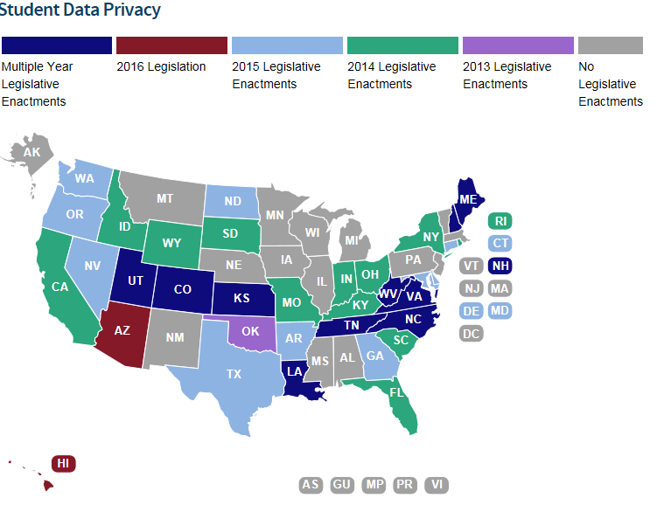

Slide 3
Privacy Laws
Family Educational Rights and Privacy Act
Protection of Pupil Rights Amendment
Individual’s with Disabilities in Education Act
Children’s Online Privacy Protection Act
Georgia’s Student Privacy, Accessibility and Transparency Act (OCGA §20-2-660 to 20-20-667)

Slide 4
Protection of Pupil Rights Amendment (PPRA)
§98.4 Protection of students' privacy in
examination, testing, or treatment.
Requires parental consent before minor students can participate in a survey that reveals certain types of information including, but not limited to, political affiliations, mental health, sexual behavior and attitudes, illegal behaviors, or income.

Slide 5
Protection of Pupil Rights Amendment (PPRA)
98.3 Access to instructional material used in a research or experimentation program.
All instructional material—including teachers' manuals, films, tapes, or other supplementary instructional material—which will be used in connection with any research or experimentation program or project shall be available for inspection by the parents or guardians of the children engaged in such program or project.

Slide 6
Children’s Online Privacy Protection Act
Prohibits unfair or deceptive acts or practices in connection with the collection, use, and/or disclosure of personal information from and about children on the Internet.

Slide 7
Children’s Online Privacy Protection Act
§312.3 Regulation of unfair or deceptive acts or practices in connection with the collection, use, and/or disclosure of personal information from and about children on the Internet.
General requirements. It shall be unlawful for any operator of a Web site or online service directed to children, or any operator that has actual knowledge that it is collecting or maintaining personal information from a child, to collect personal information from a child in a manner that violates the regulations prescribed under this part. Generally, under this part, an operator must:
(a) Provide notice on the Web site or online service of what information it collects from children, how it uses such information, and its disclosure practices for such information (§312.4(b));
(b) Obtain verifiable parental consent prior to any collection, use, and/or disclosure of personal information from children (§312.5);
(c) Provide a reasonable means for a parent to review the personal information collected from a child and to refuse to permit its further use or maintenance (§312.6);
(d) Not condition a child's participation in a game, the offering of a prize, or another activity on the child disclosing more personal information than is reasonably necessary to participate in such activity (§312.7); and
(e) Establish and maintain reasonable procedures to protect the confidentiality, security, and integrity of personal information collected from children (§312.8

Slide 8
Personally Identifiable Information (PII)
PII includes direct student identifiers (e.g., name, student identification number, Social Security number), indirect identifiers (e.g., date of birth, address), and any other information that alone, or in combination with other information, is linked or linkable to a specific individual and would allow a reasonable person in the school community to identify the student (34CFR §99.3).

Slide 9
Personally Identifiable Information (PII)
There is no definitive list of data elements considered to be PII under FERPA.
Aggregate or tabular data may be considered PII under FERPA if it includes information about individuals or small groups with unique or uncommon characteristics or extreme values
Any student information may potentially be PII if it can be used by a reasonable person in the school community to identify the student.

Slide 10
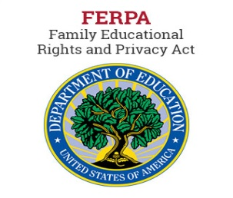
FERPA – Family Education Rights and Privacy
Parent means a parent of a student and includes a natural parent, a guardian, or an individual acting as a parent in the absence of a parent or a guardian
Eligible student means a student who has reached 18 years of age or is attending an institution of postsecondary education.
Once a student reaches 18 years of age or attends a postsecondary institution, he or she becomes an "eligible student," and all rights formerly given to parents under FERPA transfer to the student

Slide 11
FERPA – Family Education Rights and Privacy
FERPA is a Federal law that is administered by the Family Policy Compliance Office (FPCO) in the U.S. Department of Education (USDOE).
A federal law designed to protect the privacy of student education records and to allow parents and/or legal guardians and eligible student’s access to the student’s education record.
FERPA applies to all educational agencies and institutions (e.g., schools) that receive funding under any program administered by the USDOE.

Slide 12
FERPA - Parental Rights
The right to inspect and review the student's education records within 45 days after the day the (“School”)] receives a request for access.
The right to request the amendment of the student’s education records that the parent or eligible student believes are inaccurate, misleading, or otherwise in violation of the student’s privacy rights under FERPA.
The right to provide written consent before the school discloses personally identifiable information (PII) from the student's education records, except to the extent that FERPA authorizes disclosure without con­sent.

Slide 13
FERPA Data Disclosure without Parental Approval
To other school officials, including teachers, within the educational agency or institution whom the school has determined to have legitimate educational interests
To officials of another school, school system, or institution of postsecondary education where the student seeks or intends to enroll, or where the student is already enrolled if the disclosure is for purposes related to the student’s enrollment or transfer
To authorized representatives of the U. S. Comptroller General, the U. S. Attorney General, the U.S. Secretary of Education, or State and local educational authorities,
In connection with financial aid for which the student has applied or which the student has received
To State and local officials or authorities to whom information is specifically allowed to be reported

Slide 14
FERPA Data Disclosure without Parental Approval
To organizations conducting studies for, or on behalf of, the school, in order to: (a) develop, validate, or administer predictive tests; (b) administer student aid programs; or (c) improve instruction. (§99.31(a)(6))
To accrediting organizations to carry out their accrediting functions. (§99.31(a)(7))
To parents of an eligible student if the student is a dependent for IRS tax purposes. (§99.31(a)(8))
To comply with a judicial order or lawfully issued subpoena. (§99.31(a)(9))
To appropriate officials in connection with a health or safety emergency, subject to §99.36. (§99.31(a)(10)
Information the school has designated as “directory information” under §99.37. (§99.31(a)(11))

Slide 15
FERPA Parental / Eligible Student Rights
What must an educational agency or institution include in its annual notification? $§99.7$
What rights exist for a parent or eligible student or inspect and review educational records? $§99.$10
May an educational agency or institution charge a fee for copies of education records? $§99.11$
What limitations exist on the right to inspect and review records? $§99.12$
How can a parent or eligible student request amendment of the student’s education records? $§99.20$
Under what conditions does a parent or eligible student have the right to a hearing? $§99.21$

Slide 16
FERPA Parental / Eligible Student Rights
Under what conditions is prior consent required to disclose information? §99.30
Under what conditions is prior consent not required to disclose information? §99.31
What recordkeeping requirements exist concerning requests and disclosures? §99.32

Slide 17
Four Exceptions
FERPA allows four exceptions under which student PII may be shared without the consent of parents or eligible students.
School Official Exception
Studies Exception
Audit or Evaluation Exception
Directory Information Exception

Slide 18
School Official Exception
Schools and LEAs may share student PII among designated school officials with a legitimate educational interest.
Outside parties may be considered school officials if they are performing a service for which the school or LEA would otherwise use employees.
LEAs define who constitutes a school official with legitimate educational interest in their annual notification of rights under FERPA.

Slide 19
Studies Exception
Allows the disclosure of student PII to third parties that are conducting certain studies for, or on behalf of, educational agencies or institutions.
These studies need to be for the specific (limited) purpose of developing, validating, or administering a predictive test, administering a student aid program, or improving instruction.
Under FERPA, the education agency must first execute a written agreement with the organization conducting the activity.

Slide 20
Audit or Evaluation Exception
Allows the disclosure of student PII to authorized representatives of federal, state, and local educational authorities for the audit or evaluation of federal- or state-supported education programs.

Slide 21
Directory Information Exception
Schools may disclose certain student PII without the consent of the parent or eligible student. However, schools must first notify parents of the specific data elements the district is designating as directory information, and allow parents a reasonable amount of time to “opt out” of having their children’s information shared under this exception.
Schools must keep track of the children whose parents have opted out of sharing information, and ensure that information about these children is not included when directory information about other students is shared.
The school district’s directory information policy may be included as part of the requisite annual notification of FERPA rights, or it may be distributed separately.

Slide 22
Directory Information Exception
Directory information can be defined as PII that is generally not considered harmful or an invasion of privacy if released.
LEAs are responsible for developing the directory information policy that will be used in their schools.
The list of data elements considered to be directory information will vary among LEAs.

Slide 23
Directory Information Exception
Some districts may choose to adopt a Limited Directory Information policy. Under this type of policy, an LEA can either
designate the specific entities that may receive directory information, or
designate the specific purposes for which directory information may be shared.

Slide 24
Directory Information Exception
Limited directory information policy.
Parents and eligible students must still be notified of the directory information policy and allowed to opt out.
Some districts may decide to adopt such a policy because it gives them better control over which organizations can have access to the data.
In particular, schools and districts in states or localities that have open record laws may find it difficult to refuse to share directory information with an external organization unless the district has specifically adopted a limited directory information policy

Slide 25
Recordation
An educational agency or institution must maintain a record of each request for access to and each disclosure of personally identifiable information from the education records of each student

Slide 26
Recordation
Recordation: FERPA does not require educational agencies and institutions to record disclosures of appropriately designated directory information (§ 99.32(d)(4)).

Slide 27
Recordation
Recordation: FERPA (§ 99.32(d)(2)) does not require educational agencies and institutions to record disclosures of PII from education records to school officials under § 99.31(a)(1)

Slide 28
Recordation
Recordation: FERPA requires educational agencies and institutions to record all disclosures of PII from education records to organizations made under the studies exception (§ 99.32).

Slide 29
Recordation
Recordation: FERPA requires educational agencies and institutions to record all disclosures of PII from education records made under the audit or evaluation exception (§ 99.32). ➢
State and local educational authorities (and other FERPA-permitted entities listed in § 99.31(a)(3)) redisclosing PII on behalf of the educational agency or institution must record disclosures according to the requirements in § 99.32(b)(2).

Slide 30
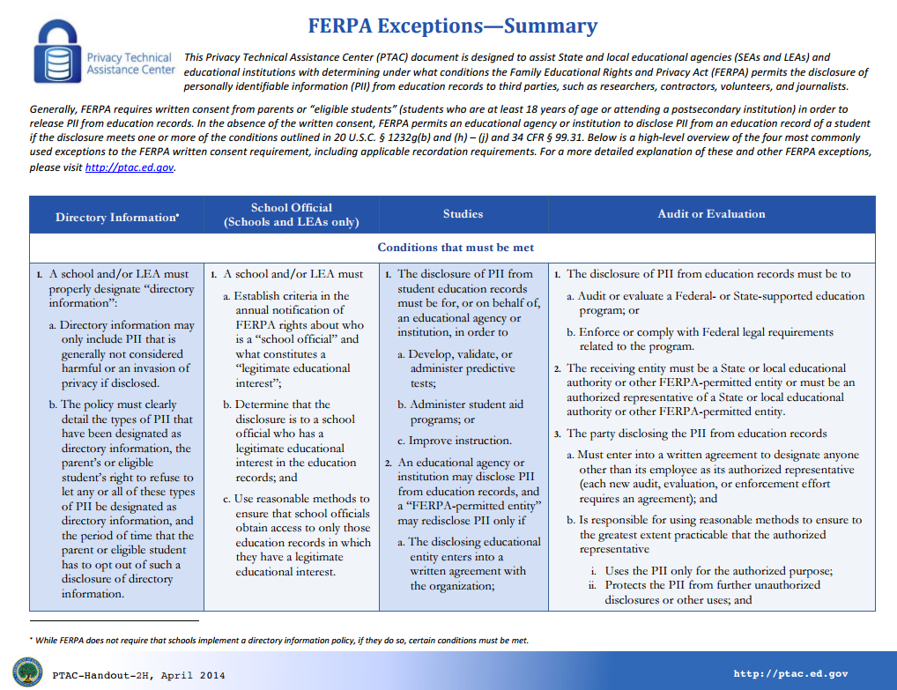
FERPA Exceptions and Recordation Requirements

Slide 31
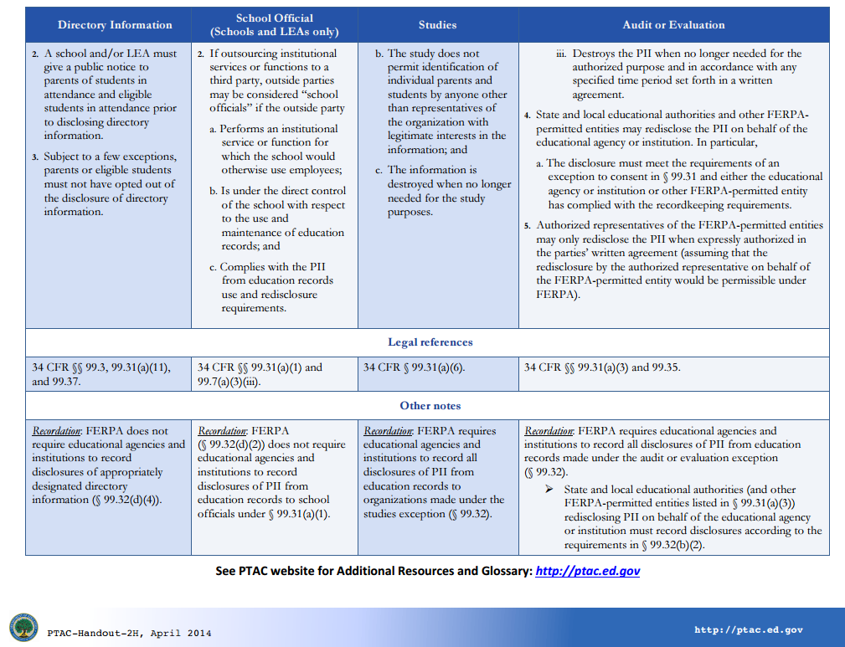

Slide 32
Individual’s with Disabilities in Education Act
IDEA is the federal law designed to protect students with disabilities and ensure they receive equitable treatment.
FERPA requirements apply under IDEA.
One difference, however, is that under IDEA when a child with disabilities reaches the age of 18 and becomes an “eligible” student under FERPA, an education agency must continue to send notifications to the parents in addition to the eligible student.

Slide 33
New Resource Now Available
Forum Guide to Education Data Privacy

Slide 34
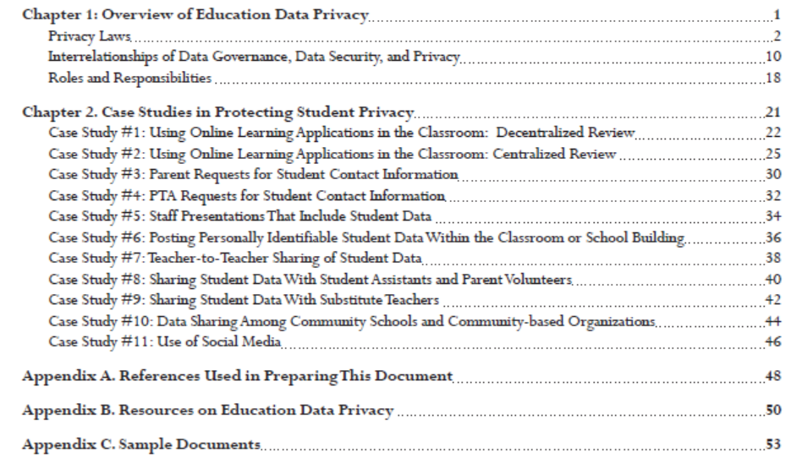
Forum Guide to Education Data Privacy Table of Contents

Slide 35
Student Data Privacy, Accessibility, and Transparency Act -
20-2-661 – 20-20-667
The General Assembly acknowledges that student data is a vital resource for parents, teachers, and school staff, and it is the intent of the General Assembly to ensure that student data is safeguarded and that students' and parents' privacy is honored, respected, and protected.

Slide 36
Support LEAs in their Responsibility to:
Annually notify parents of their right to request student information;
Ensure security when providing student data to parents;
Produce education records and student data included in such education records to parents and eligible students, ideally within three business days of the request;
Implement technologies and programs that allow a parent to view online, download, and transmit data specific to his or her child's education record;
Create policies and procedures for parents to file a complaint with a local school system regarding a possible violation of rights under this article or under other federal or state student data privacy and security laws.

Slide 37
PARENT/ELIGIBLE STUDENT DATA PRIVACY COMPLAINT POLICY
Summary
The Student Data Privacy, Accessibility, and Transparency Act is a Georgia state law that is designed to ensure student data is kept private and secure from unauthorized access. Any parent or eligible student (“Complainant”) may file a complaint with the local school system if that individual believes and alleges that a possible violation of rights under the federal or state privacy and security laws has occurred. A parent is defined as a natural parent, as guardian, or an individual acting as a parent in the absence of a parent or guardian. An eligible student is defined as a student who has reached 18 years of age or is attending an institution of postsecondary education.
PURPOSE
O.C.G.A. § 20-2-667 Parental and student review of education record; model policies subsection (g)(1) directs the Georgia Department of Education to develop model policies and procedures for a parent or eligible student to file a complaint with an LEA regarding a possible violation of rights under federal or state student data privacy and security laws.
SCOPE
The purpose of this policy is to ensure that parents or eligible students are provided a formal process to file a complaint with a local school system regarding a possible violation and to set forth the official process that the local school system must use to handle the complaint. The complaint must allege a violation that occurred not more than one (1) year prior to the date that the complaint is received.
Complaint policy must be adopted by LEA by January 2017.

Slide 38
PARENT/ELIGIBLE STUDENT DATA PRIVACY COMPLAINT POLICY
POLICY
Local school systems must provide the Parent/Eligible Student Complaint form to the Complainant within 3 business days of receiving the request. The complaint form may also be made available on the local school system’s website. See Parent/Eligible Student Complaint Form.
Each local school system shall designate at least one individual with the responsibility to respond to complaints filed by parents or eligible students.
A written response must be provided to Complainant within 10 business days of receipt of complaint.
The Complainant may file an appeal with the local school superintendent within 10 business days of receiving written response from local school system.
Parents or eligible student may file an appeal for a final decision to the local board of education within 10 business days of receipt of written response from local school system.
Local boards of education must render a decision within 10 business days of receiving an appeal.
Complaint policy must be adopted by LEA by January 2017.

Slide 39
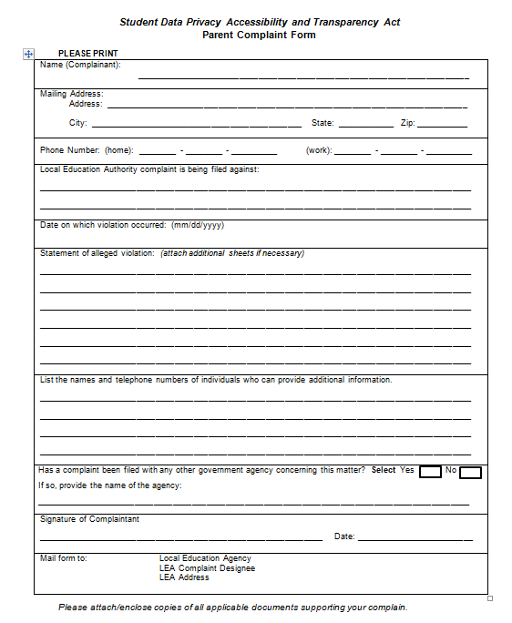
Model Policies and Forms Created for Local Education Agencies
Complaint policy must be adopted by LEA by January 2017.

Slide 40
Annual Notification Policy
SUMMARY
The Student Data Privacy, Accessibility, and Transparency Act of Georgia and the Family Educational Rights and Privacy Act (FERPA) require local education agencies who receive federal funds to notify parents and eligible students of their rights under FERPA. A parent is defined as a natural parent, as guardian, or an individual acting as a parent in the absence of a parent or guardian. An eligible student is defined as a student who has reached 18 years of age or is attending an institution of postsecondary education.
PURPOSE
O.C.G.A. § 20-2-664 Role of department section (7) directs the Georgia Department of Education to develop model policies and procedures for local education agencies to ensure the provision of at least annual notifications to eligible students and parents or guardians regarding student privacy rights under federal and state law.
SCOPE
Each local educational agency shall annually notify parents of students currently in attendance, or eligible students currently in attendance, of their rights under FERPA.

Slide 41
Annual Notification Policy
The annual notification must inform parents or eligible students that they have the right to –
Inspect and review the student’s education records
Seek amendment of the student’s education records that the parent or eligible student believes to be inaccurate, misleading, or otherwise in violation of the student’s privacy rights
Consent to disclosures of personally identifiable information contained in the student’s education record
File with the USDOE a complaint concerning alleged failures by the educational agency or institution to comply with the requirements of FERPA
The notice must include all of the following:
The procedure for exercising the right to inspect and review education records
The procedure for requesting amendment of records
An educational agency may provide this notice by any means that are reasonably likely to inform the parents or eligible student of their rights.
An educational agency shall effectively notify parents or eligible students who are disabled.
An educational agency shall effectively notify parents who have a primary or home language other than English.

Slide 42
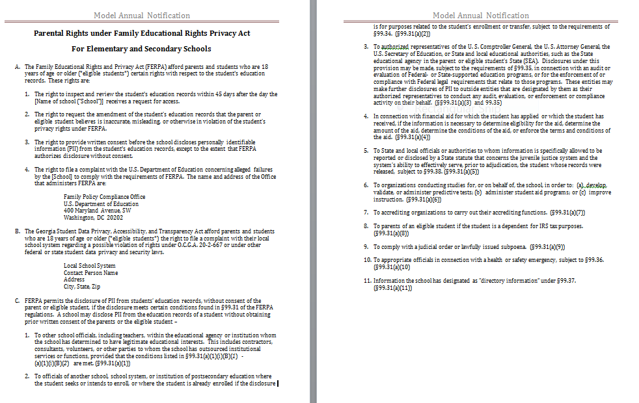
Model Policies and Forms Created for Local Education Agencies

Slide 43
Data Privacy, Accessibility and Transparency Act
Accessibility
Data Privacy

Slide 44
Data Privacy Accessibility and Transparency Act
New policies – available on web
Data Element Glossary – available on web
Complaint policy must be implemented within district within 6 month.
New student-level data elements posted for public comment until September 26, 2016.

Slide 45
Contact Information: Levette Williams – lewillia@doe.k12.ga.us

